Slide 1
Oracle Data Guard Broker: Overview

Slide 2
Objectives
After completing this lesson, you should be able to describe:
  The Data Guard broker architecture
  Data Guard broker components
  Benefits of the Data Guard broker
  Data Guard broker configurations
  How to use Enterprise Manager to manage your Data Guard configuration
  How to invoke DGMGRL to manage your Data Guard configuration
Notes:
Oracle Database 11g: Data Guard Administration 3 - <number>

Slide 3
Oracle Data Guard Broker: Features
  The Oracle Data Guard broker is a distributed management framework.
  The broker automates and centralizes the creation, maintenance, and monitoring of Data Guard configurations.
  With the broker, you can perform all management operations locally or remotely with easy-to-use interfaces:
    Oracle Enterprise Manager Grid Control
    DGMGRL (a command-line interface)
Notes:
Oracle Database 11g: Data Guard Administration 3 - <number>
Oracle Data Guard Broker: Features
The following are some of the operations that the broker automates and simplifies:
Automated creation of Data Guard configurations incorporating a primary database, a new or existing standby database, redo transport services, and log apply services
Note: Any of the databases in the configuration can be a Real Application Clusters (RAC) database.
Adding up to eight new or existing standby databases to each existing Data Guard configuration, for a total of one primary database and from one to nine standby databases in the same configuration
Managing an entire Data Guard configuration (including all databases, redo transport services, and log apply services) through a client connection to any database in the configuration
Invoking switchover or failover with a single command to initiate and control complex role changes across all databases in the configuration
Monitoring the status of the entire configuration, capturing diagnostic information, reporting statistics (such as the log apply rate and the redo generation rate), and detecting problems quickly with centralized monitoring, testing, and performance tools

Slide 4


Data Guard Broker: Components
  Client-side:
    Oracle Enterprise Manager Grid Control
    DGMGRL (command-line interface)
  Server-side: Data Guard monitor
    DMON process
    Configuration files
Notes:
Oracle Database 11g: Data Guard Administration 3 - <number>
Data Guard Broker: Components
The Oracle Data Guard broker consists of both client-side and server-side components.
On the client, you can use the following Data Guard components to define and manage a configuration:
Oracle Enterprise Manager
DGMGRL, which is the Data Guard command-line interface (CLI)
On the server, the Data Guard monitor is a broker component that is integrated with the Oracle database. The Data Guard monitor comprises the Data Guard monitor (DMON) process and broker configuration files, with which you can control the databases of that configuration, modify their behavior at run time, monitor the overall health of the configuration, and provide notification of other operational characteristics.
The configuration file contains profiles that describe the current state and properties of each database in the configuration. Associated with each database are various properties that the DMON process uses to control the database’s behavior. The properties are recorded in the configuration file as a part of the database’s object profile that is stored there. Many database properties are used to control database initialization parameters related to the Data Guard environment.

Slide 5

Data Guard Broker: Configurations
The most common configuration is a primary database at one location and a standby database at another location.
pc00prmy
pc00sby1
Oracle Net
Primary site
Standby site
Notes:
Oracle Database 11g: Data Guard Administration 3 - <number>
Data Guard Broker: Configurations
A Data Guard configuration consists of one primary database and up to nine standby databases. The databases in a Data Guard configuration are typically dispersed geographically and are connected by Oracle Net.
A Data Guard broker configuration is a logical grouping of the primary and standby databases in a Data Guard configuration. The broker’s DMON process configures and maintains the broker configuration components as a unified group of resource objects that you can manage and monitor as a single unit.

Slide 6
Data Guard Broker: Management Model
Data Guard Broker Configuration
Standby database
Broker-controlled databases
Standby database
Standby database
Standby database
Standby database
Standby database
Standby database
Standby database
Primary database
Standby database
Instances
Instances
Notes:
Oracle Database 11g: Data Guard Administration 3 - <number>
Data Guard Broker: Management Model
The Data Guard broker performs operations on the following logical objects:
Configuration of databases
Single database
A broker configuration consists of:
Configuration object
A named collection of database profiles. A database profile is a description of a database object, including its current state, current status, and properties.
Database objects
Objects corresponding to primary or standby databases
Instance objects
A database object may comprise one or more instance objects if it is a RAC database.
The broker supports one or more Data Guard configurations, each of which includes a profile for one primary database as well as profiles for up to nine physical, logical, RAC or non-RAC standby databases.

Slide 7



Data Guard Broker: Architecture
Graphical user interface
or
command-line interface
Data Guard Configuration
Standby site 9
Standby site 2
Primary site
Standby site 1
Configuration
files
Configuration
files
Standby
database
Standby
redo logs
Log
apply
services
Primary
database
DMON
DMON
Online
redo logs
Online
redo logs
Archived
redo logs
Archived
redo logs
Log
transport
services
Oracle
Net
Standby
redo logs
Notes:
Oracle Database 11g: Data Guard Administration 3 - <number>
Data Guard Broker: Architecture
The Data Guard broker helps you create, control, and monitor a Data Guard configuration. This configuration consists of a primary database that is protected by one or more standby databases. After the broker has created the Data Guard configuration, the broker monitors the activity, health, and availability of all systems in that configuration.
The Data Guard monitor process (DMON) is an Oracle background process that runs on every instance that is managed by the broker. When you start the Data Guard broker, a DMON process is created.
When you use Enterprise Manager or the Data Guard command-line interface (CLI), the DMON process is the server-side component that interacts with the local instance and the DMON processes that are running on other sites to perform the requested function. The DMON process is also responsible for monitoring the health of the broker configuration and for ensuring that every instance has a consistent copy of the configuration files in which the DMON process stores its configuration data. There are two multiplexed versions of the configuration file on each instance.

Slide 8
Data Guard Monitor: DMON Process
  Server-side background process
  Part of each database instance in the configuration
  Created when you start the broker
  Performs requested functions and monitors the resource
  Communicates with other DMON processes in the configuration
  Updates the configuration file
  Creates the drc<SID> trace file in the location set by the DIAGNOSTIC_DEST initialization parameter
  Modifies initialization parameters during role transitions as necessary
Notes:
Oracle Database 11g: Data Guard Administration 3 - <number>
Data Guard Monitor: DMON Process
The Data Guard monitor comprises two components: the DMON process and the configuration file.
The DMON process is an Oracle background process that is part of each database instance managed by the broker. When you start the Data Guard broker, a portion of the SGA is allocated and a DMON process is created. The amount of memory allocated is typically less than 50 KB per site; the actual amount on your system varies.
When you use Enterprise Manager or the CLI, the DMON process is the server-side component that interacts with the local instance and the DMON processes running on other sites to perform the requested function.
The DMON process is also responsible for monitoring the health of the broker configuration and for ensuring that every database has a consistent copy of the broker configuration files in which the DMON process stores its configuration data.

Slide 9
Benefits of Using the Data Guard Broker
  Enhances the high-availability, data protection, and disaster protection capabilities inherent in Oracle Data Guard by automating both configuration and monitoring tasks
  Streamlines the process for any one of the standby databases to replace the primary database and take over production processing
  Enables easy configuration of additional standby databases
  Provides simplified, centralized, and extended management
  Automatically communicates between the databases in a Data Guard configuration by using Oracle Net Services
  Provides built-in validation that monitors the health of all databases in the configuration
Notes:
Oracle Database 11g: Data Guard Administration 3 - <number>
Benefits of Using the Data Guard Broker
By automating the tasks required to configure and monitor a Data Guard configuration, the broker enhances the high-availability, data protection, and disaster protection capabilities that are inherent in Oracle Data Guard. If the primary database fails, the broker streamlines the process for any one of the standby databases to replace the primary database and take over production processing.
The broker enables easy configuration of additional standby databases. After creating a Data Guard configuration consisting of a primary and a standby database, you can add up to eight standby databases to each Data Guard configuration.

Slide 10
Comparing Configuration Management
With and Without the Data Guard Broker
 | With the Broker | Without the Broker
General | Manage databases as one | Manage databases separately
Creation of the standby database | Use Grid Control wizards | Manually create files
Configuration and management | Configure and manage from single interface | Set up services manually for each database
Monitoring | Monitor continuously Unified status and reports Integrate with EM events | Monitor each database individually through views
Control | Invoke role transitions with a single command | Coordinate sequences of multiple commands across database sites for role transitions
Notes:
Oracle Database 11g: Data Guard Administration 3 - <number>
Comparing Configuration Management With and Without the Data Guard Broker
The table in the slide provides an overview of configuration management with and without the Data Guard broker (source: Table 1-1, “Configuration Management With and Without the Broker,” in Oracle Data Guard Broker).

Slide 11
Data Guard Broker Interfaces
  Command-line interface (CLI):
    Is started by entering DGMGRL at the command prompt where the Oracle server or an Oracle client is installed
    Enables you to control and monitor a Data Guard configuration from the prompt or in scripts
  Oracle Enterprise Manager Grid Control:
    Provides wizards to simplify creating and managing standby databases
Notes:
Oracle Database 11g: Data Guard Administration 3 - <number>
Data Guard Broker Interfaces
The DGMGRL command-line interface includes:
Configuration and setup tasks
Management and control of the configuration
Commands to check the status and health of the configuration
Commands to execute role changes
Oracle Enterprise Manager Grid Control includes the following Data Guard features:
Wizard-driven creation of standby databases
Wizard-driven creation of a broker configuration based on an existing primary and standby database
Complete monitoring and proactive event reporting through email or pagers
Simplified control of the databases through their potential states. For example, with Enterprise Manager you can start or stop the redo transport services, start or stop the log apply services, and place a standby database in read-only mode.
“Pushbutton” switchover and failover. Grid Control enables you to execute a switchover or failover between a primary and a standby database by simply clicking a button.
Note: After defining a Data Guard broker configuration, you should use DGMGRL or Enterprise Manager Grid Control to manage your configuration. You should not use SQL commands to manage the databases because you could cause a conflict with the broker.

Slide 12
Using the Command-Line Interface of the Data Guard Broker
DGMGRL> connect sys/oracle
Connected.
DGMGRL> show configuration verbose
Configuration
Name: DGConfig1
Enabled: YES
Protection Mode: MaxAvailability
Databases:
pc00prmy - Primary database
pc00sby1 - Physical standby database
Fast-Start Failover: DISABLED
Current status for "DGConfig1":
SUCCESS
Notes:
Oracle Database 11g: Data Guard Administration 3 - <number>
DGMGRL Commands
The following commands are available in DGMGRL (the Data Guard CLI).
Note: Many of these commands have additional arguments that are not described here. See Oracle Data Guard Broker for detailed information.
ADD: Adds a standby database to the broker configuration
CONNECT: Connects a given username to the specified instance
CREATE: Enables you to create broker configurations
DISABLE: Enables you to disable broker control of a configuration or database so that the object is no longer managed by the broker
EDIT: Used to edit a configuration, database, or instance
ENABLE: Enables you to enable broker control of a configuration or database
EXIT/QUIT: Exits DGMGRL
FAILOVER: Performs a database failover operation in which one of the standby databases changes to the role of primary database (This is an unplanned transition that may result in the loss of application data.)
HELP: Displays online help for the commands in DGMGRL
REINSTATE: Changes a disabled database into a viable standby database
REMOVE: Removes a broker configuration, including all of its database profiles, a specified standby database profile, or knowledge of an instance

Slide 13
Notes:
Oracle Database 11g: Data Guard Administration 3 - <number>
DGMGRL Commands (continued)
SHOW: Displays either a brief or a detailed summary of information about the broker configuration, database, or instance; can also display the dependency tree and default online states for the broker configuration, as well as the configuration log or the Oracle database alert log
SHUTDOWN: Shuts down a currently running Oracle database instance
START: Starts the Fast-Start Failover Observer
STARTUP: Starts an Oracle instance with several options, including mounting and opening a database
STOP: Stops the Fast-Start Failover Observer
SWITCHOVER: Performs a switchover operation in which the current primary database becomes a standby database and the standby database to which the CLI is currently connected becomes the primary database

Slide 14
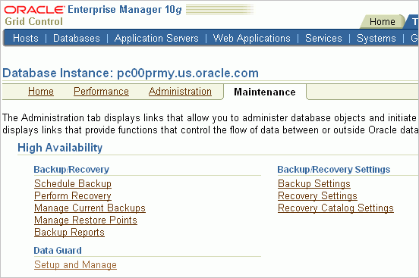
Using Oracle Enterprise Manager 10g
Grid Control
Click “Setup and Manage” to access the Data Guard pages.
Notes:
Oracle Database 11g: Data Guard Administration 3 - <number>
Using Oracle Enterprise Manager 10g Grid Control
To access the Data Guard features in Grid Control:
1. Click the Targets tab to go to the Targets page.
2. Click Databases to go to the Databases page, where you can see a list of all discovered databases, including the primary database.
3. Click the primary database to go to the primary database home page.
4. Click Maintenance.
5. Click “Setup and Manage” in the Data Guard section of the Maintenance page to open the Data Guard Overview page.

Slide 15
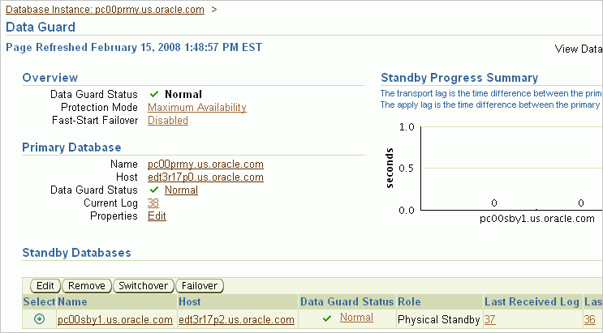
Data Guard Overview Page
Notes:
Oracle Database 11g: Data Guard Administration 3 - <number>
Data Guard Overview Page
On the Data Guard Overview page, you can:
View the protection mode and access the page to edit the protection mode
View a summary showing the amount of data that the standby database has not received
View information about the primary database
View or access pages to change information for the standby databases:
Add a standby database to the broker configuration
Change the state or properties
Discontinue Data Guard broker control
Switch the role from standby to primary
Transition the standby database to the role of primary database
Access pages to view performance information for the configuration and status of online redo log files for each standby database
Perform a verification process on the Data Guard configuration
Click Help to access information about each page.
Note: You access the Data Guard Overview page by clicking “Setup and Manage” in the Data Guard section of the database Maintenance page.

Slide 16
Benefits of Using Enterprise Manager
  Enables you to manage your configuration by using a familiar interface and event-management system
  Automates and simplifies the complex operations of creating and managing standby databases through the use of wizards
  Performs all Oracle Net Services configuration changes that are necessary to support redo transport services and log apply services
  Provides a verify operation to ensure that redo transport services and log apply services are configured and functioning properly
  Enables you to select a new primary database from a set of viable standby databases
Notes:
Oracle Database 11g: Data Guard Administration 3 - <number>
Benefits of Using Enterprise Manager
Managing your Data Guard configuration with Oracle Enterprise Manager Grid Control provides the following benefits:
Enables you to manage your configuration using the familiar Enterprise Manager interface and event-management system
Provides a wizard that automates the complex tasks involved in creating a broker configuration
Provides the Add Standby Database Wizard to guide you through the process of adding more databases
Performs all Oracle Net Services configuration changes that are necessary to support redo transport services and log apply services across the configuration
Provides a verify operation to ensure that redo transport services and log apply services are configured and functioning properly
Enables you to select a new primary database from a set of viable standby databases when you need to initiate a role change for a switchover or failover operation

Slide 17
Summary
In this lesson, you should have learned how to:
  Describe the Data Guard broker management model
  Describe the Data Guard broker architecture
  Describe Data Guard broker components
  Access Enterprise Manager
  Invoke DGMGRL (the Data Guard command-line interface)
Notes:
Oracle Database 11g: Data Guard Administration 3 - <number>

